Slide 1
SALESEASE A web-based sales and customer management system
By Bishal Somare and Pranish Sris
Supervisor: Suraj Khattri

Slide 2
Introduction
“Sales Ease” is an efficient and scalable sales and operational management system developed for Ganapati enterprises. This system focuses on automating key business process, streamlining sales workflows, and enhancing operational precision to meet the demands of a fast paced and competitive business environment.

Slide 3
Problem Definition
Faces inefficient inventory and sales management due to lack of an integrated system.
Results in poor data security and time-consuming document storage.
Challenges in tracking sales and stock levels.
Existing system cannot detect expired products.
Unable to generate sales reports or provide accurate sales data.

Slide 4
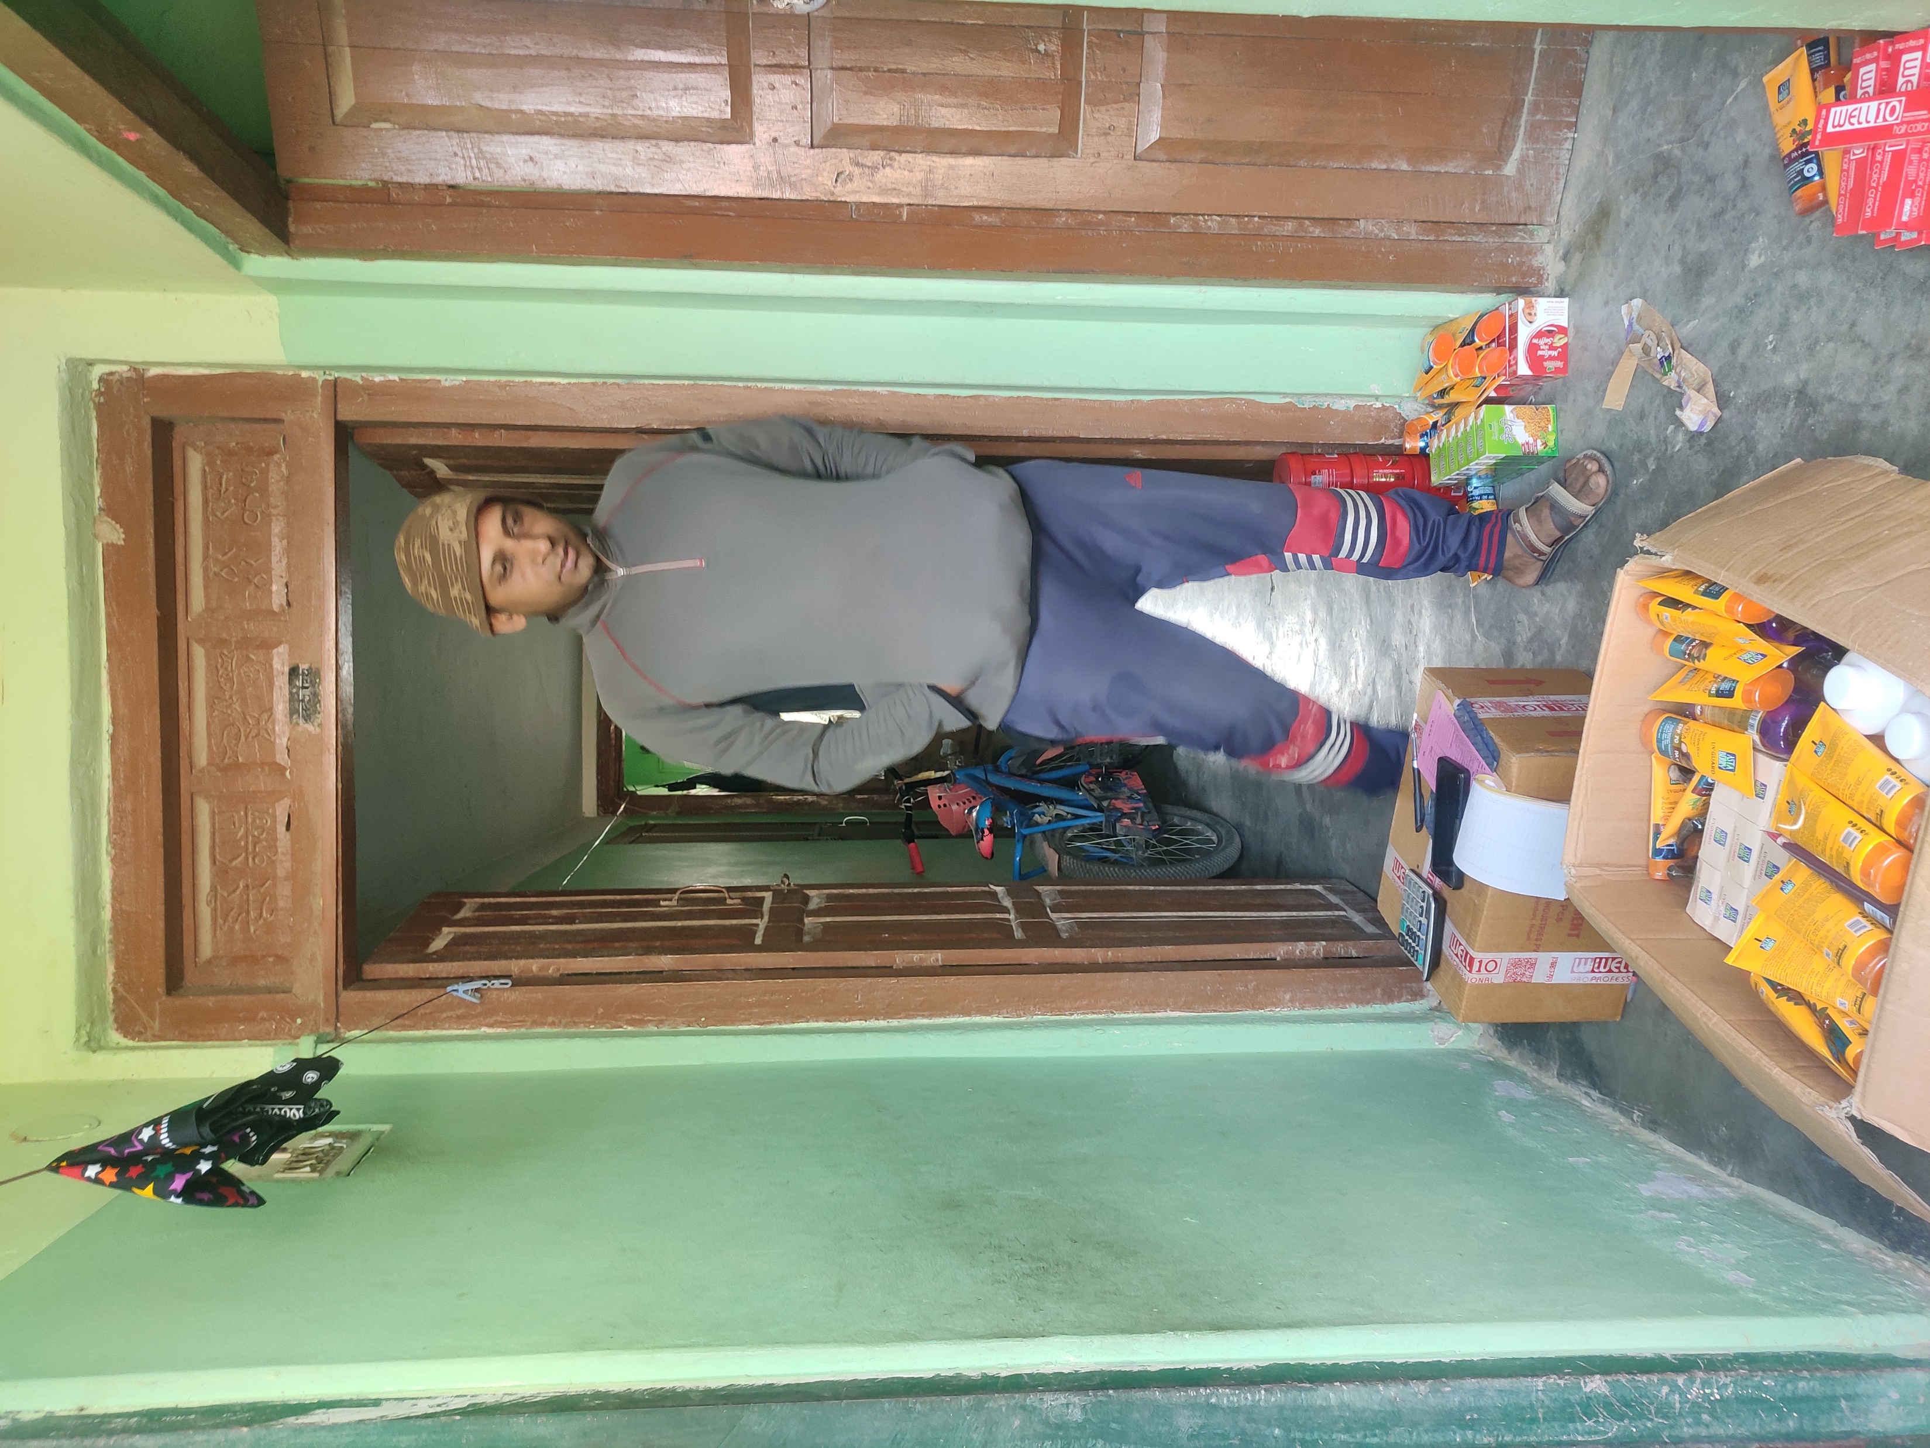
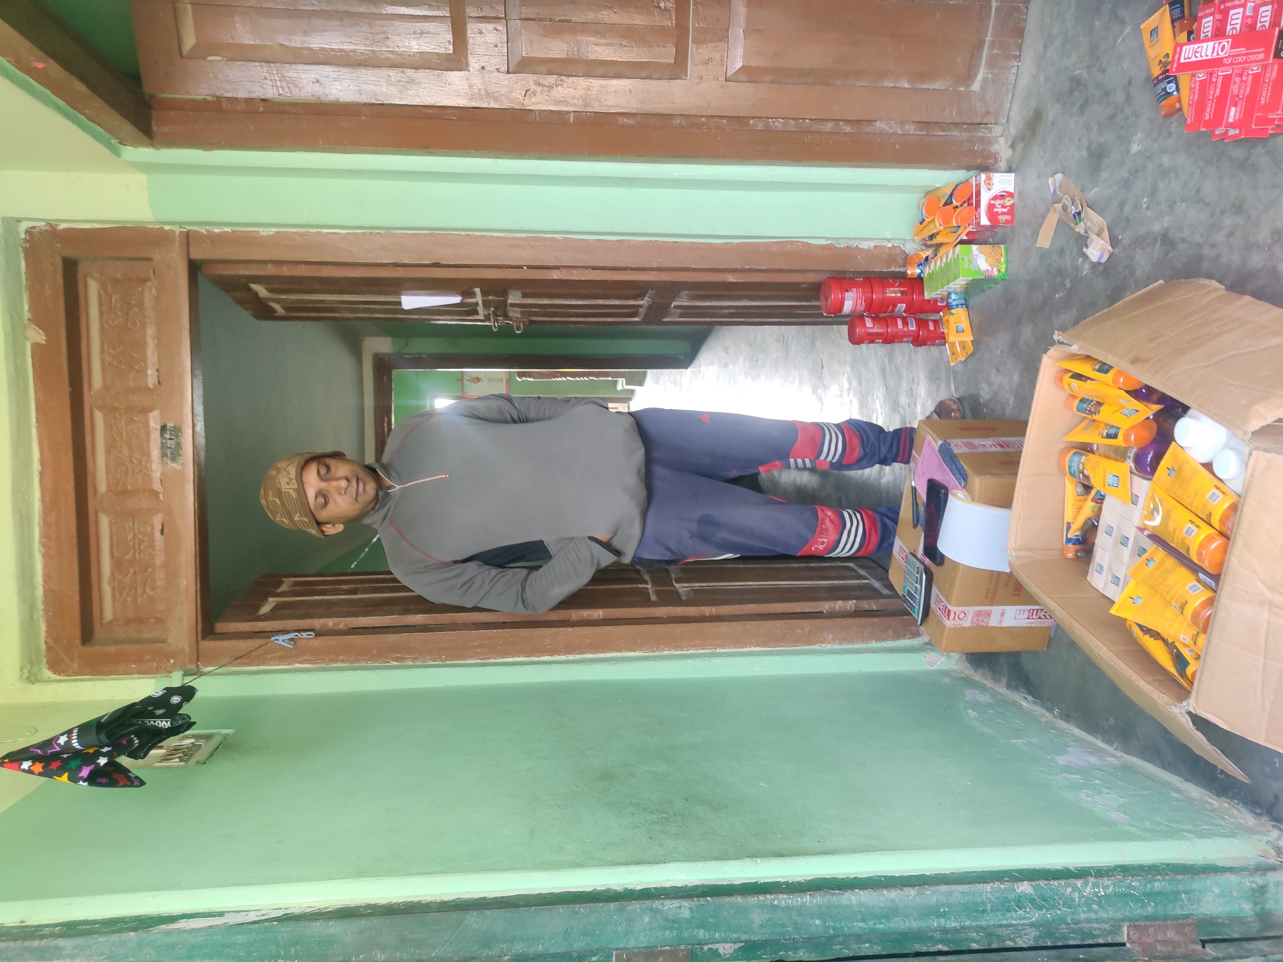
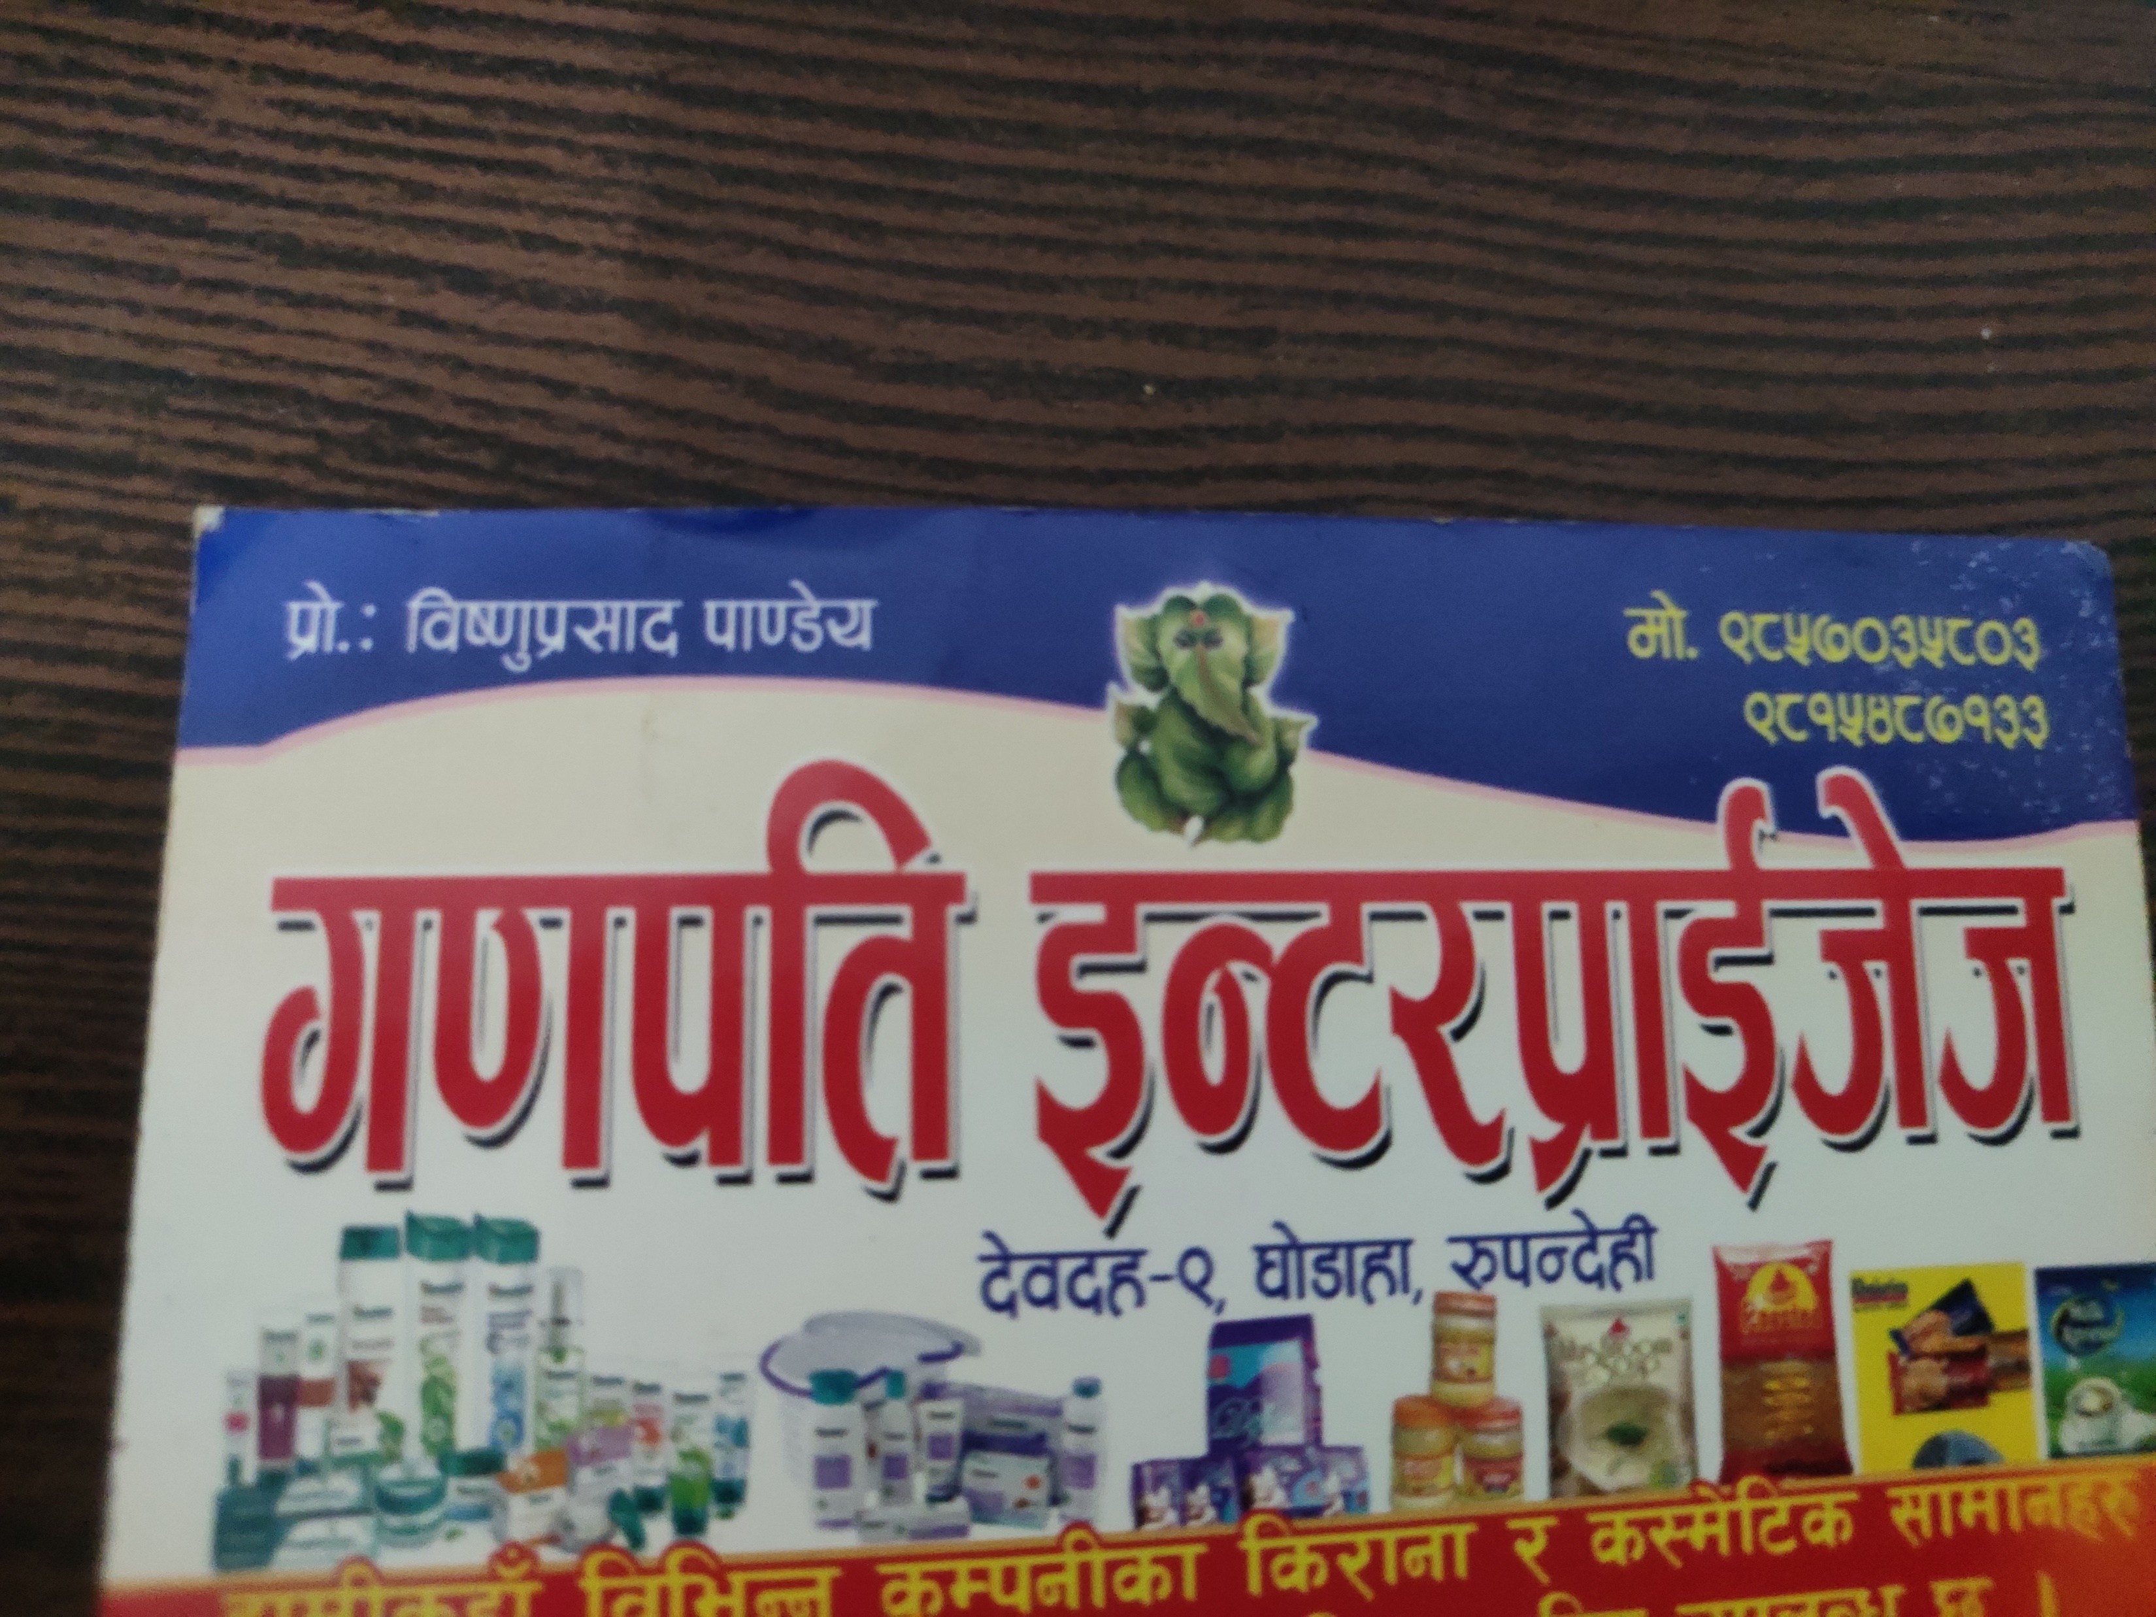

Slide 5
Objectives
To automatically generate report on sales and inventory activities.
To provide notifications on low level of stock.
To generate receipt for customer references.

Slide 6
Scope
It focuses on enhancing efficiency in managing customer data, tracking sales transactions, monitoring inventory, and generating useful insights via dashboards.

Slide 7
Limitations
It is designed for web-based environments, without offline access or a mobile application.

Slide 8
Methodology
Software Development Model
Study of Existing System
Requirement Analysis
Feasibility Analysis
Tools used

Slide 9
Software Development
Requirement & analysis
Design
Implementation
Testing
Deployment
Figure 1:WaterFall Model

Slide 10
Study of Existing System
Salesforce is a leading customer relationship management (CRM) platform, focusing on sales automation, marketing, and customer service. It offers customizability and advanced analytics for businesses
Zoho CRM from Zoho is a cloud-based customer relationship management (CRM) platform to manage the sales, marketing and customer support facets of business-to-business (B2B) and business-to-customer (B2C) (Houpes, 2015).

Slide 11
Requirement Analysis
Functional Requirements
Admin can registered sales admin and inventory admin.
Secure login for users (admin and staffs).
Inventory admin can track real-time inventory levels.
Admin and inventory admin can manage inventory.
System will notify the admin when stock reach ROL.
Admin and sales admin can view the sales history of customer and products.
Admin and sales admin can manage customer information.
Admin and inventory admin can manage vendor.

Slide 12
Non-functional Requirements
Performance
Security
Usability
Maintainability
Reliability

Slide 13
Feasibility Analysis
Technical Feasibility
Optimizing processing time for tasks ensures a responsive and smooth user experience.
Designed for maintainability with clear documentation and modular components, enabling easy updates and troubleshooting.

Slide 14
Operational Feasibility
The system is designed with a fully GUI-based interface, ensuring ease of use for all types of user, including non-technical staff.
The system automates repetitive tasks such as data management, reducing manual effort and improving operational efficiency.

Slide 15
Economic Feasibility
The project leverages open-source technologies, reducing licensing costs.
Minimal hardware investment is required.

Slide 16
Tools Used
Frontend
• HTML5, CSS, Bootstrap, AJAX, JavaScript 5.5.2.
Backend
• Django(Python)
Database
• MySQL
IDE For Development
• Visual Studio Code
Version Control
• Git
• GitHub

Slide 17
Overview of System

Slide 18
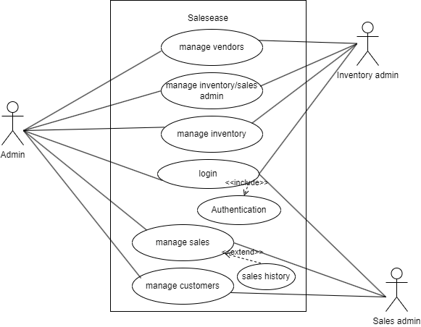
Figure 2:Use Case Diagram of Sales ease

Slide 19
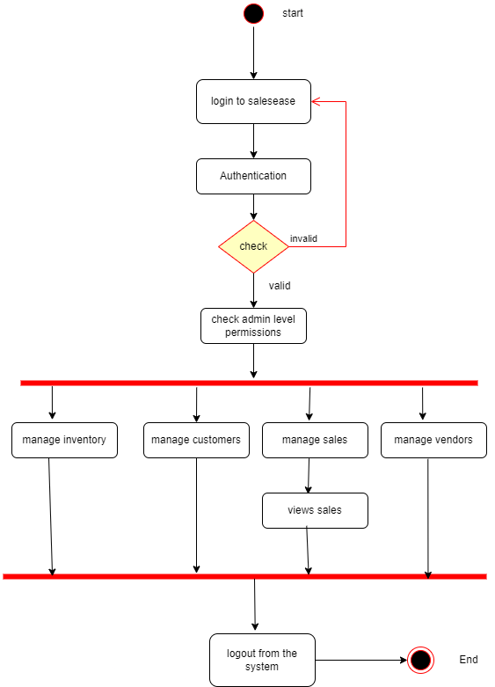
Figure 3:Activity Diagram of Salesease

Slide 20
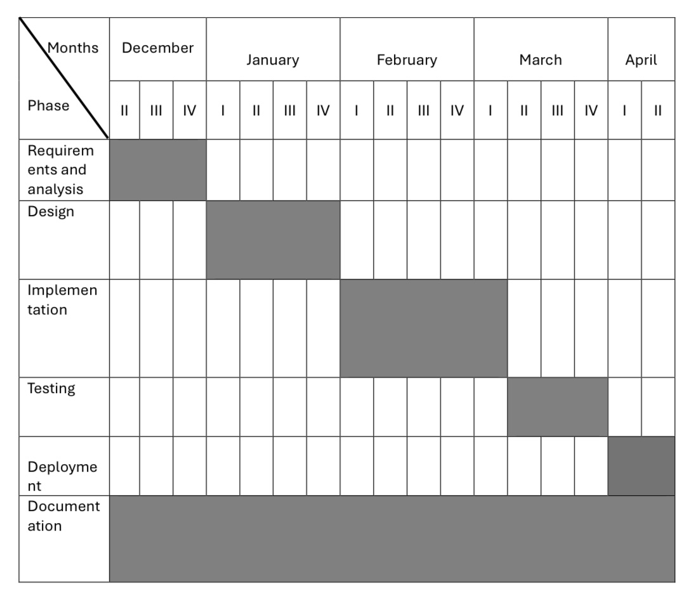
Gantt Chart for the project

Slide 21
Expected Outcomes
“Sales Ease” is expected to:
• Notifications on low stock level.
• Elimination of manual data entry and reduction of errors.
• Generation of receipts for customer references.

Slide 22


